Slide 1
Object Oriented Software Engineering (OOSE)
22CS017
Object Oriented Testing

Slide 2
Object Oriented Testing in Software Testing
Software typically undergoes many levels of testing, from unit testing to system or acceptance testing. Typically, in-unit testing small “units”, or modules of the software, are tested separately with a focus on testing the code of that module. In higher-order testing (e.g, acceptance testing ) the entire system (or a subsystem) is tested with a focus on testing the functionality or external behavior of the system.
As information systems are becoming more complex, the object-oriented paradigm is gaining popularity because of its benefits in analysis, design, and coding. Conventional testing methods cannot be applied for testing classes because of problems involved in testing classes, abstract classes, inheritance, dynamic binding, message, passing, polymorphism, concurrency, etc. Testing classes is a fundamentally different issue than testing functions. A function (or a procedure) has a clearly defined input-output behavior, while a class does not have an input-output behavior specification.

Slide 3
Cont..
We can test a method of a class using approaches for testing functions, but we cannot test the class using these approaches.
Data dependencies between variables
Calling dependencies between modules
Functional dependencies between a module and the variable it computes
Definitional dependencies between a variable and its types.
But in Object-Oriented systems, there are the following additional dependencies:
Class-to-class dependencies
Class to method dependencies
Class to message dependencies
Class to variable dependencies
Method to variable dependencies
Method to message dependencies
Method to method dependencies

Slide 4
Cont..
Issues in Testing Classes:
Additional testing techniques are, therefore, required to test these dependencies. Another issue of interest is that it is not possible to test the class dynamically, only its instances i.e, objects can be tested. Similarly, the concept of inheritance opens various issues e.g., if changes are made to a parent class or super class, in a larger system of a class it will be difficult to test subclasses individually and isolate the error to one class.
In object-oriented programs, control flow is characterized by message passing among objects, and the control flow switches from one object to another by inter-object communication. Consequently, there is no control flow within a class like functions. This lack of sequential control flow within a class requires different approaches for testing. Furthermore, in a function, arguments passed to the function with global data determine the path of execution within the procedure.
But, in an object, the state associated with the object also influences the path of execution, and methods of a class can communicate among themselves through this state because this state is persistent across invocations of methods.
Hence, for testing objects, the state of an object has to play an important role. Techniques of object-oriented testing are as follows:

Slide 5
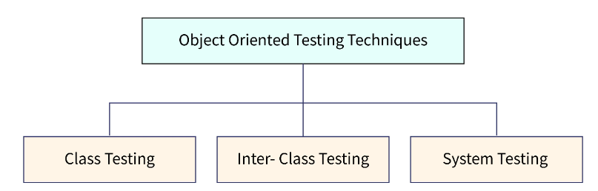
Object-oriented Testing in Software Testing
Initially, we were following the traditional method of testing which consists of procedures operating on data. But now, we are following the object-oriented testing method that focuses on the objects that are instances of classes. This change from traditional to object-oriented made us reconsider old strategies and software testing methods. There are many advantages of using the OO paradigm including reliability, interoperability, reusability, and extendibility.
Different Levels of Object-Oriented Testing in Software Testing

Slide 6
Cont..
Object Oriented testing can be performed at different levels to detect the issues. At the algorithmic level, a single module of every class should be tested. As discussed earlier, testing of classes is the main concern of the Object Oriented program. Every class gets tested as an individual entity at the class level. Generally, programmers who are creating the classes are involved in testing. Test cases for Object-Oriented Testing in Software Testing can be constructed based on the requirement specifications, programming language, and models.
Once class-level testing is done, Cluster level testing will be performed. Cluster-level testing is the integration of individual classes. The main purpose of doing integration testing is to verify the interconnection between classes and how well they perform interclass interactions. Thus, Cluster level testing can be viewed as integration testing of classes.
Once Cluster level testing is performed, system-level testing begins. At this level, integration between clusters can be taken care of. Also, at each level regression testing is a must after every new release.

Slide 7
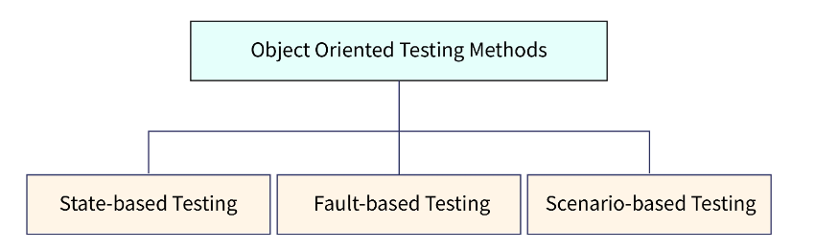
Object-Oriented Testing Levels /Techniques
Object Oriented Testing in Software Testing techniques are:

Slide 8
Cont..
Fault-based testing: The main focus of fault-based testing is based on consumer specifications or code or both. Test cases are created in a way to identify all possible faults and flush them all. This technique finds all the defects that include incorrect specification and interface errors. In the traditional testing model, these types of errors can be detected through functional testing. While Object Oriented Testing in Software Testing will require scenario-based testing.
Scenario-based testing: This testing technique is useful to detect issues due to wrong specifications and improper interaction among the classes. Incorrect interactions lead to incorrect output which can cause the malfunctioning of some segments sometimes. Scenario-based testing focuses on how the end user will perform the task in a specific environment. These scenarios are more detailed and created concerning the user’s requirements rather than product-specific.
Scenario-based testing combines all the classes included in created use cases and tests them all. The main purpose of this is to verify that all the methods of classes get tested at least once while performing Object Oriented Testing in Software Testing. However, it is difficult to test each object in a large system. Thus, the top-down or bottom-up integration approach gets followed.
The scenario-based testing technique has been considered the most effective method of the OO program.

Slide 9
Cont..
Challenges in Testing Object-oriented Programs
Issues with Object Oriented Testing in Software Testing
Dynamic testing of classes is not possible in an OO program because it allows instances of classes to be tested. Therefore, additional testing techniques are required to test the interconnection between classes.
In object-oriented programs, control flow can be monitored with message passing between objects. It changes from one object to another with intercommunication. To test these sequential flows different types of testing approaches will be required.
Inheritance of objects is an important part of the OO program. In a larger system, it is difficult to test the subclass and detect errors in one class.
The state associated with a particular object influences the methods, execution, and communication between classes. Therefore, the state plays a vital role in object-oriented testing in software testing.

Slide 10
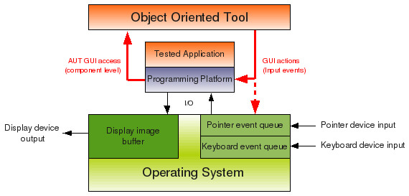
Testing Object-Oriented Applications
Object-oriented testing is a type of software testing that focuses on verifying the behaviour of individual objects or classes in an object-oriented system.
The goal of OO testing is to ensure that each object or class in the system performs its functions correctly and interacts appropriately with other objects or classes.
Figure 1: Structure of Object-Oriented Testing

Slide 11
Object-Oriented Testing Techniques
Fault Based Testing:
This checking permits for coming up with test cases supported the consumer specification or the code or both. It tries to identify possible faults (areas of design or code that may lead to errors.).
For all of these faults, a test case is developed to “flush” the errors out.
These tests also force each time of code to be executed.
This method of testing does not find all types of errors.
However, incorrect specification and interface errors can be missed. These types of errors can be uncovered by function testing in the traditional testing model.
In the object-oriented model, interaction errors can be uncovered by scenario-based testing.
This form of Object-oriented testing can only test against the client’s specifications, so interface errors are still missed.

Slide 12
Object-Oriented Testing Techniques
2. Class Testing Based on Method Testing: This is the simplest approach to test classes. Each method of the class performs a well-defined cohesive function and can, therefore, be related to unit testing of the traditional testing techniques. Therefore all the methods of a class can be involved at least once to test the class.
Random Testing: It is supported by developing a random test sequence that tries the minimum variety of operations typical to the behavior of the categories
Partition Testing: This methodology categorizes the inputs and outputs of a category so as to check them severely. This minimizes the number of cases that have to be designed.
Scenario-based Testing: It primarily involves capturing the user actions then stimulating them to similar actions throughout the test. These tests tend to search out interaction form of error.

Slide 13
Purpose of Object-Oriented Testing
Object Interaction Validation: Check to make sure objects interact with one another appropriately in various situations. Testing makes ensuring that the interactions between objects in object-oriented systems result in the desired results.
Determining Design Errors: Find the object-oriented design’s limitations and design faults. Testing ensures that the design complies with the desired architecture by assisting in the identification of problems with inheritance, polymorphism, encapsulation and other OOP concepts.
Finding Integration Problems: Evaluate an object’s ability to integrate and communicate with other objects when it is part of a bigger component or subsystem. This helps in locating integration difficulties, such improper method calls or issues with data exchange.

Slide 14
Purpose of Object-Oriented Testing
Assessment of Reusable Code: Evaluate object-oriented code’s reusability. Code reuse is promoted by object-oriented programming via features like inheritance and composition. Testing ensures that reusable parts perform as intended in various scenarios.
Verification of Handling Exceptions: Confirm that objects respond correctly to error circumstances and exceptions. The purpose of object-oriented testing is to make sure that the software responds carefully and is durable in the face of unforeseen occurrences or faults.
Verification of Uniformity: Maintain uniformity inside and between objects and the object-oriented system as a whole. Maintainability and readability are enhanced by consistency in naming standards, coding styles and compliance to design patterns.

Slide 15
Object-Oriented Applications and Design
Object-Oriented Analysis and Design (OOAD):
a software engineering methodology that involves using object-oriented concepts to design and implement software systems.
involves a number of techniques and practices, including object-oriented programming, design patterns, UML diagrams, and use cases.
Some important aspects of OOAD:
Object-Oriented Programming: involves modeling real-world objects as software objects, with properties and methods that represent the behavior of those objects. OOAD uses this approach to design and implement software systems.
Design Patterns: are reusable solutions to common problems in software design. OOAD uses design patterns to help developers create more maintainable and efficient software systems.

Slide 16
Object-Oriented Applications and Design
Object-Oriented Analysis and Design (OOAD)
3. Unified Modeling Language (UML) Diagrams: is a standardized notation for creating diagrams that represent different aspects of a software system.
UML diagrams are used to represent the different components and interactions of a software system.
4. Use Cases: are a way of describing the different ways in which users interact with a software system.
Use cases are used to help developers understand the requirements of a system and to design software systems that meet those requirements.

Slide 17
Advantages and Disadvantages of OOAD
Advantages:
Reusability: OOAD emphasizes the use of reusable components and design patterns, which can save time and effort in software development.
Scalability: OOAD can help developers design software systems that are scalable and can handle changes in user demand and business requirements over time.
Maintainability: OOAD emphasizes modular design and can help developers create software systems that are easier to maintain and update over time.
Flexibility: OOAD can help developers design software systems that are flexible and can adapt to changing business requirements over time.
Disadvantages to using OOAD:
Complexity: can be complex and may require significant expertise to implement effectively.
Time-consuming: can be a time-consuming process that involves significant upfront planning and documentation.
Rigidity: Once a software system has been designed using OOAD, it can be difficult to make changes without significant time and expense.
Cost: can be more expensive than other software engineering methodologies due to the upfront planning and documentation required.
Overall, OOAD can be an effective approach to designing and implementing software systems, particularly for complex or large-scale projects. However, it’s important to weigh the advantages and disadvantages carefully before adopting this approach.

Slide 18
Object-Oriented Analysis
Object-Oriented Analysis (OOA)
the first technical activity performed as part of object-oriented software engineering. OOA introduces new concepts to investigate a problem.
It is based on a set of basic principles, which are as follows-
The information domain is modeled.
Behavior is represented.
The function is described.
Data, functional, and behavioral models are divided to uncover greater detail.
Early models represent the essence of the problem, while later ones provide implementation details.

Slide 19
Object-Oriented Design
Object-Oriented Design (OOD):
An analysis model created using object-oriented analysis is transformed by object-oriented design into a design model that works as a plan for software creation.
OOD results in a design having several different levels of modularity i.e., The major system components are partitioned into subsystems (a system-level “modular”), and data manipulation operations are encapsulated into objects (a modular form that is the building block of an OO system.).
In addition, OOD must specify some data organization of attributes and a procedural description of each operation.
Shows a design pyramid for object-oriented systems. It is having the following four layers.

Slide 20
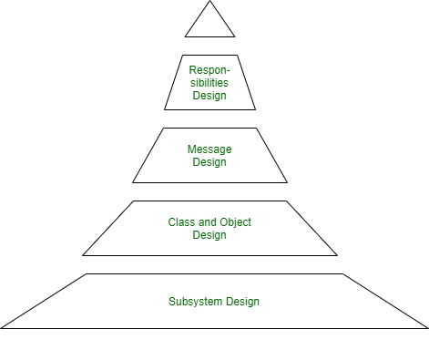
Object-Oriented Design
Figure 2: Object-Oriented Design (OOD) Pyramid

Slide 21
Object-Oriented Design
The Subsystem Layer : It represents the subsystem that enables software to achieve user requirements and implement technical frameworks that meet user needs.
The Class and Object Layer: It represents the class hierarchies that enable the system to develop using generalization and specialization. This layer also represents each object.
The Message Layer: It represents the design details that enable each object to communicate with its partners. It establishes internal and external interfaces for the system.
The Responsibilities Layer: It represents the data structure and algorithmic design for all the attributes and operations for each object.

Slide 22
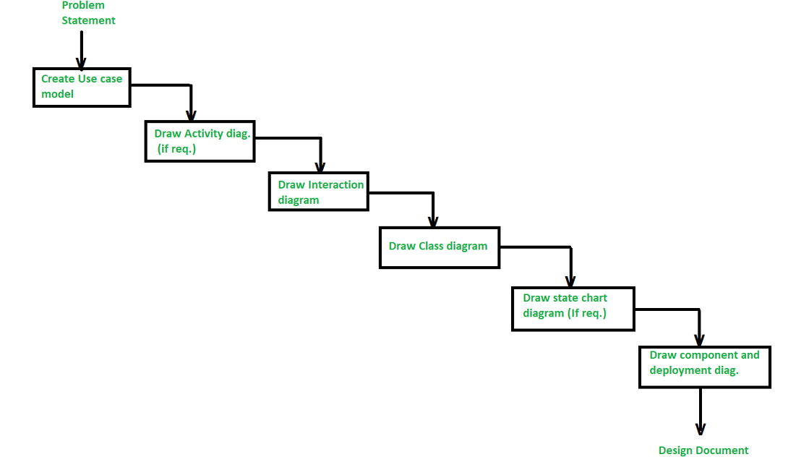
Steps to Analyze and Design Object Oriented System
Figure 3: steps/stages in the analysis and design of an object-oriented system

Slide 23
Steps to Analyze and Design Object Oriented System
There are various steps/stages in the analysis and design of an object-oriented system as given in below figure :
Create a Use case model :
The first step in the analysis and design of an object-oriented system is to recognize the actors interlinked with the system. After that, create the use case and draw the use case diagram.
2. Draw activity diagram (If required) :
The activity Diagram demonstrates the dynamic nature of a system by creating the flow of control form activity. An activity addresses a procedure on some class in the framework that outcomes in an adjustment of the condition of the system. The below figure shows the activity graph handling a request to convey a few products.
3. Draw the interaction diagram :
An interaction diagram shows a collaboration comprising a bunch of articles and their relationship, including the messages that might be dispatched among them. Interaction diagram address the unique perspective on a system.

Slide 24
Steps to Analyze and Design Object Oriented System
Steps for drawing interaction diagrams :
Initially, we ought to distinguish that the objects as for each use case.
Then we draw the sequence diagrams for each use case.
Then we draw the collaboration diagrams for each use case.
4. Draw the class diagram : The class diagram is responsible for showing the relationship between the classes. There are four types of relationships available:
Association – It is a semantic connection between classes. At the point when an association associates two classes, each class can send messages to the next in sequence or a collaboration diagram. They may be bi-directional or unidirectional in nature.
Dependencies – They connect two classes and are always unidirectional in nature and display that one class, depends on the definitions of another class.
Aggregations – They are a stronger form of association that shows the relationship between a whole and its parts.
Generalizations – They are used to display an inheritance relationship between the two classes.

Slide 25
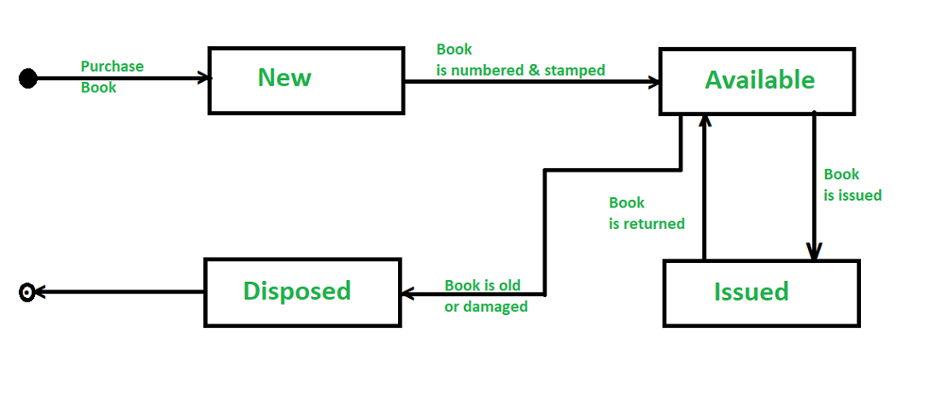
Steps to Analyze and Design Object Oriented System
5. Design of State chart diagrams :
A state chart is utilized to show the state space of a given class, the occasion that influences progress starting with one state then onto the next, and the activity that outcome from a state change. A state change graph for a “book” in the library management system is shown below :
Figure 4: State Change Graph Example
6. Draw component and development diagram :
These diagrams address the static execution perspective on a system they are identified with class diagrams in that a segment ordinarily guides to at least one class, interface, or coordinated effort.

Slide 26
Object Oriented Testing Strategies
1. Class Testing:
▪ Class testing is also known as unit testing.
▪ In class testing, every individual classes are tested for errors or bugs.
▪ Class testing ensures that the attributes of class are implemented as per the design and specifications.It checks whether the interfaces and methods are error free of not.
▪ Unit testing is the responsibility of the application engineer who implements the structure.
▪ It involves three aspects:
₋ Testing each method
₋ Testing the relations among class methods
₋ Testing the inheriting relation between class and subclass
▪ Rather than testing an individual module, the smallest testable unit is the encapsulated class or object. This is so because a class can contain a number of different operations and a particular operation may exist as part of a number of different classes.
▪ Class testing for OO software is the equivalent of unit testing for conventional ware.
▪ Unlike unit testing class testing for OO software is driven by the operations encapsulated by the class and the state behavior of the class.

Slide 27
Object Oriented Testing Strategies
▪ How is class testing different from conventional testing?
▪ Conventional testing focuses on input- process-output, whereas class testing focuses on each method, then designing sequences of methods to exercise states of a class.
Testing methods applicable at the class level
▪ Testing “in the small” focuses on a single class and the methods that are encapsulated by the class.
▪ Random testing and partitioning are methods that can be used to exercise a class during OO testing.
Random Testing for OO Classes:
▪ It requires large numbers data permutations and combinations, and can be inefficient
▪ Identify operations applicable to a class
▪ Define constraints on their use
▪ Identify a minimum test sequence
▪ Generate a variety of random test sequences.
Partition Testing at the Class Level:
▪ Partition testing reduces the number of test cases required to exercise the class in much the same manner as equivalence partitioning for traditional software.
▪ Input and output are categorized and test cases are designed to exercise each category.

Slide 28
Object Oriented Testing Strategies
▪ State-based partitioning:
₋ It categorizes class operations based on their ability to change the state of the class.
₋ Test designed in such a way that operations that cause state changes are tested
separately from those that do not.
▪ Attribute-based partitioning:
₋ For each class attribute, operations are classified according to those that use the attribute, those that modify the attribute and those that do not use or modify the attributes.
▪ Category-based partitioning:
₋ It categorizes class operations based on the generic function that each performs.
₋ For example, operations in the Account class can be categorized in initialization operations (open, setup), computational operations (deposit, withdraw), queries (balance, summarize, creditLimit), and termination operations (close).

Slide 29
Object Oriented Testing Strategies
2. Integration testing:
▪ also called as interclass or subsystem testing.
▪ Interclass testing involves testing modules or sub-systems and their coordination with other modules.
Different strategies for integration testing of OO systems:
a. Thread-based testing:
▪ It integrates the set of classes required to respond to one input or event for the system.
Each thread is integrated and tested individually.
▪ Regression testing is applied to ensure that no side effect occur.
b. Use-based testing:
▪ It begins the construction of the system by testing those classes (called independent
classes) that use very few (if any) of server classes.
▪ After the Independent classes are tested, the next layer of classes, called dependent
classes, that use the independent classes are tested.
▪ This sequence of testing layers of dependent classes continue until the entire system is constructed.
c. Cluster testing:
▪ A cluster of collaborating classes is exercised by designing test cases that attempt to uncover errors in the collaboration

Slide 30
Object Oriented Testing Strategies
3. Validation Testing:
▪ It focuses on user-visible actions and user-recognizable output from the system.
▪ To assist in the derivation of validation testing, the tester should work upon the use-cases that are part of the analysis model.
▪ The use-case provides a scenario that has a high likelihood of uncovered errors in the
user interaction requirements.
▪ Conventional black-box testing methods can be used to drive validation tests.
▪ In addition, test cases may be derived from the object-behavior model and from event
flow diagram created as part of OOA.

Slide 31
Object Oriented Testing Strategies
4. System Testing:
▪ Software may be part of a larger system. This often leads to “finger pointing” by other
system dev teams.
▪ Finger pointing defence:
i. Design error-handling paths that test external information
ii. Conduct a series of tests that simulate bad data
iii. Record the results of tests to use as evidence
▪ Types of System Testing:
i. Recovery testing: how well and quickly does the system recover from faults
ii. Security testing: verify that protection mechanisms built into the system will protect
from unauthorized access (hackers, disgruntled employees, fraudsters)
iii. Stress testing: place abnormal load on the system
iv. Performance testing: investigate the run-time performance within the context of an
integrated system

Slide 32
Object Oriented Testing Levels
Unit Testing in the OO Context
When object-oriented software is considered, the concept of the unit changes. Encapsulation drives the definition of classes and objects.
This means that each class and each instance of a class packages attributes (data) and the operations that manipulate these data.
An encapsulated class is usually the focus of unit testing.
However, operations (methods) within the class are the smallest testable units. Because a class can contain a number of different operations, and a particular operation may exist as part of a number of different classes.
Class testing for OO software is the equivalent of unit testing for conventional software.
Unlike unit testing of conventional software, which tends to focus on the algorithmic detail of a module and the data that flow across the module interface,
Class testing for OO software is driven by the operations encapsulated by the class and the state behavior of the class.

Slide 33
Object Oriented Testing Strategies
Integration Testing in the OO Context
Different strategies for integration testing of OO systems.
Thread-based testing
use-based testing
Cluster testing
Thread-based testing, integrates the set of classes required to respond to one input or event for the system.
Each thread is integrated and tested individually.
Regression testing is applied to ensure that no side effects occur.
Use-based testing, Integration approach, begins the construction of the system by testing those classes (called independent classes) that use very few (if any) server classes.
After the independent classes are tested, the next layer of classes, called dependent classes, that use the independent classes are tested.
This sequence of testing layers of dependent classes continues until the entire system is constructed.
Cluster testing is one step in the integration testing of OO software.
Here, a cluster of collaborating classes is exercised by designing test cases that attempt to uncover errors in the collaborations.

Slide 34
Practice Questions
Q1. The construction of object-oriented software begins with the creation of a) design model b) analysis model c) code levels d) both design and analysis model Answer: d
Q2. Which testing integrates the set of classes required to respond to one input or event for the system?
cluster testing
thread-based testing
c) use-based testing
d) none of the mentioned
Answer: b
Q3. In which of the following testing strategies, a smallest testable unit is the encapsulated class or object? a) Unit testing b) Integration testing c) System testing d) None of the mentioned
Answer: a

Slide 35
Bibliography
https://www.javatpoint.com/difference-between-object-oriented-testing-and-conventional-testing
https://www.tutorialspoint.com/object_oriented_analysis_design/ooad_testing_quality_assurance.htm
https://www.softwaretestinghelp.com/types-of-software-testing/
https://www.techtarget.com/searchsoftwarequality/definition/integration-testing

Slide 36
THANK YOU

